Slide 1
DontDump TheYums
Final Sprint 3 Report

Slide 2
Meet the team
Gerald Susanteo
01
04
Joseph Nguyen
UI/UX Designer
Full Stack Engineer
Daniel Quach
Henry Tran
02
03
Full Stack Engineer
Project Manager
Database Designer
Notes:
Henry

Slide 3
Project introduction recap
Focus
Our idea
To address the issue of food waste by helping users better manage their food inventory. It aims to minimize waste through timely tracking of expiration dates, promoting the donation of still edible but unwanted items, and encouraging smarter food use based on what users already have. Ultimately contributing to a more sustainable and responsible food consumption.
Providing users with a digital inventory system where they can log food items along with images, quantities, and expiration dates. As items near expiration, they are flagged in a dedicated section for expiring foods. To further reduce waste, the system promotes food donations and includes a recipe search feature that suggests meals based on available ingredients. This not only prevents spoilage but also encourages creative and efficient use of food resources.
Notes:
Henry

Slide 4
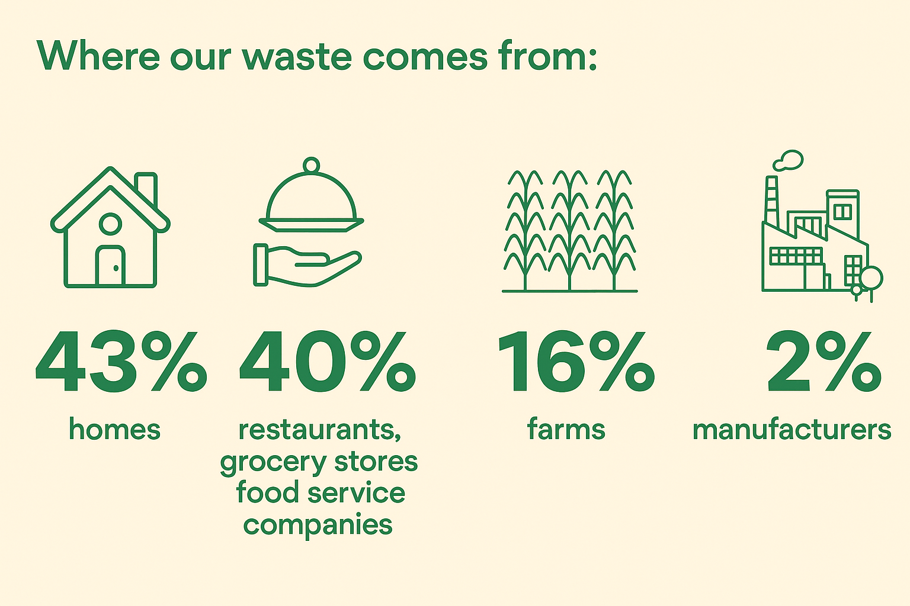
Background
US Waste 2025 Reports
More than 80 percent of Americans discard perfectly good, consumable food simply because they misunderstand expiration labels
Americans discard more food than any other country, nearly 40 million tons or 30-40 percent of the entire US food supply.
It is estimated that nearly 35 million people across America
including 10 million children suffer from food insecurity
Americans waste about 60 million tons of food every year.
Sources:
https://www.rts.com/resources/guides/food-waste-america/
https://www.epa.gov/facts-and-figures-about-materials-waste-and-recycling/food-material-specific-data#:~:text=EPA%20estimates%20that%20in%202025,beverage%20manufacturing%20and%20processing%20sectors.
https://www.usda.gov/about-food/food-safety/food-loss-and-waste/food-waste-faqs
Notes:
Henry

Slide 5
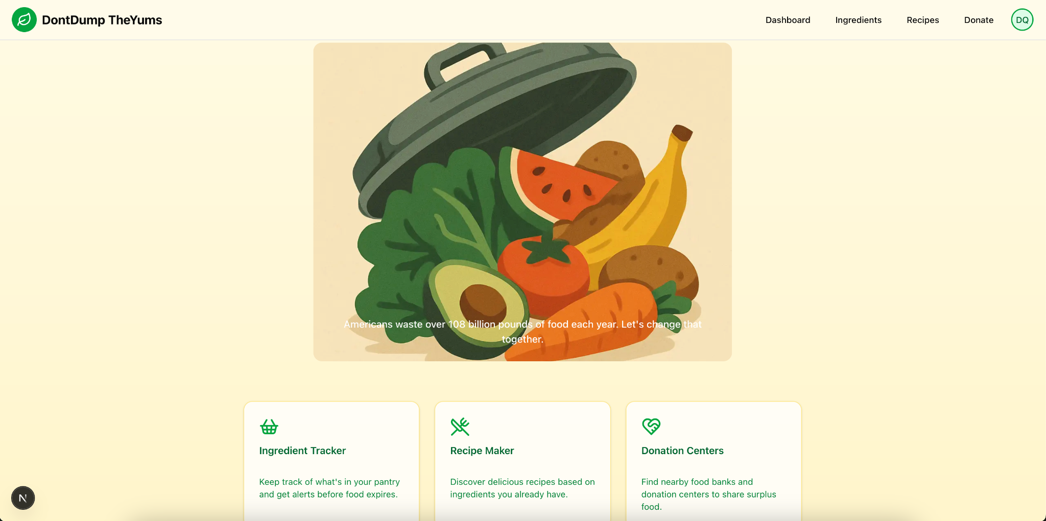
Current functionality
All the frontend elements should now be colored instead of white plain white or black.
There is now user authentication using Clerk and user tables are checked on sign in for the event of a new or existing user
Users can add ingredients by searching and selecting results given by an API.
When removing these ingredients either due to usage, or due to expiration, an AI generated recommendation will be displayed giving recyclability or compostability information.
The recipes page allows users to search for recipes either via text or by selecting ingredients in their virtual pantry.
The donation page shows the locations of the nearest food banks around the user
Notes:
Joseph

Slide 6
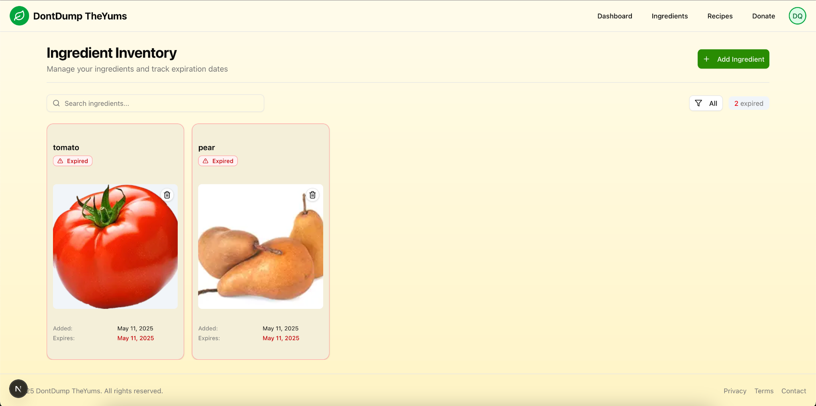
Ingredient inventory snapshot
01
Notes:
Joseph

Slide 7
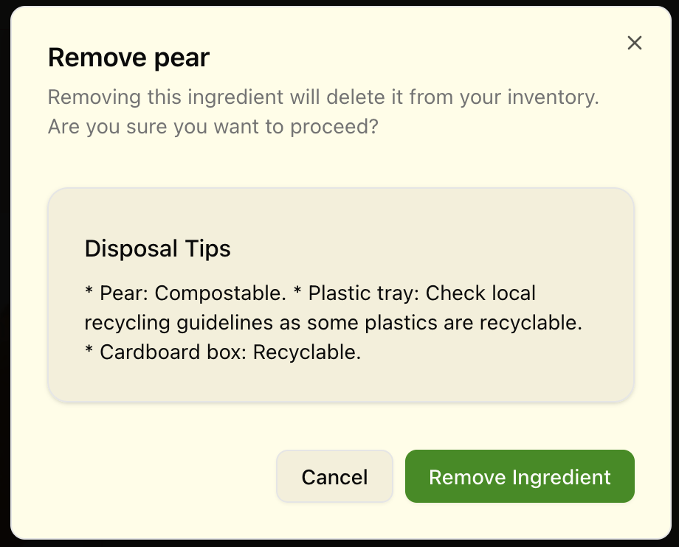
Removing snapshot
Notes:
Joseph

Slide 8
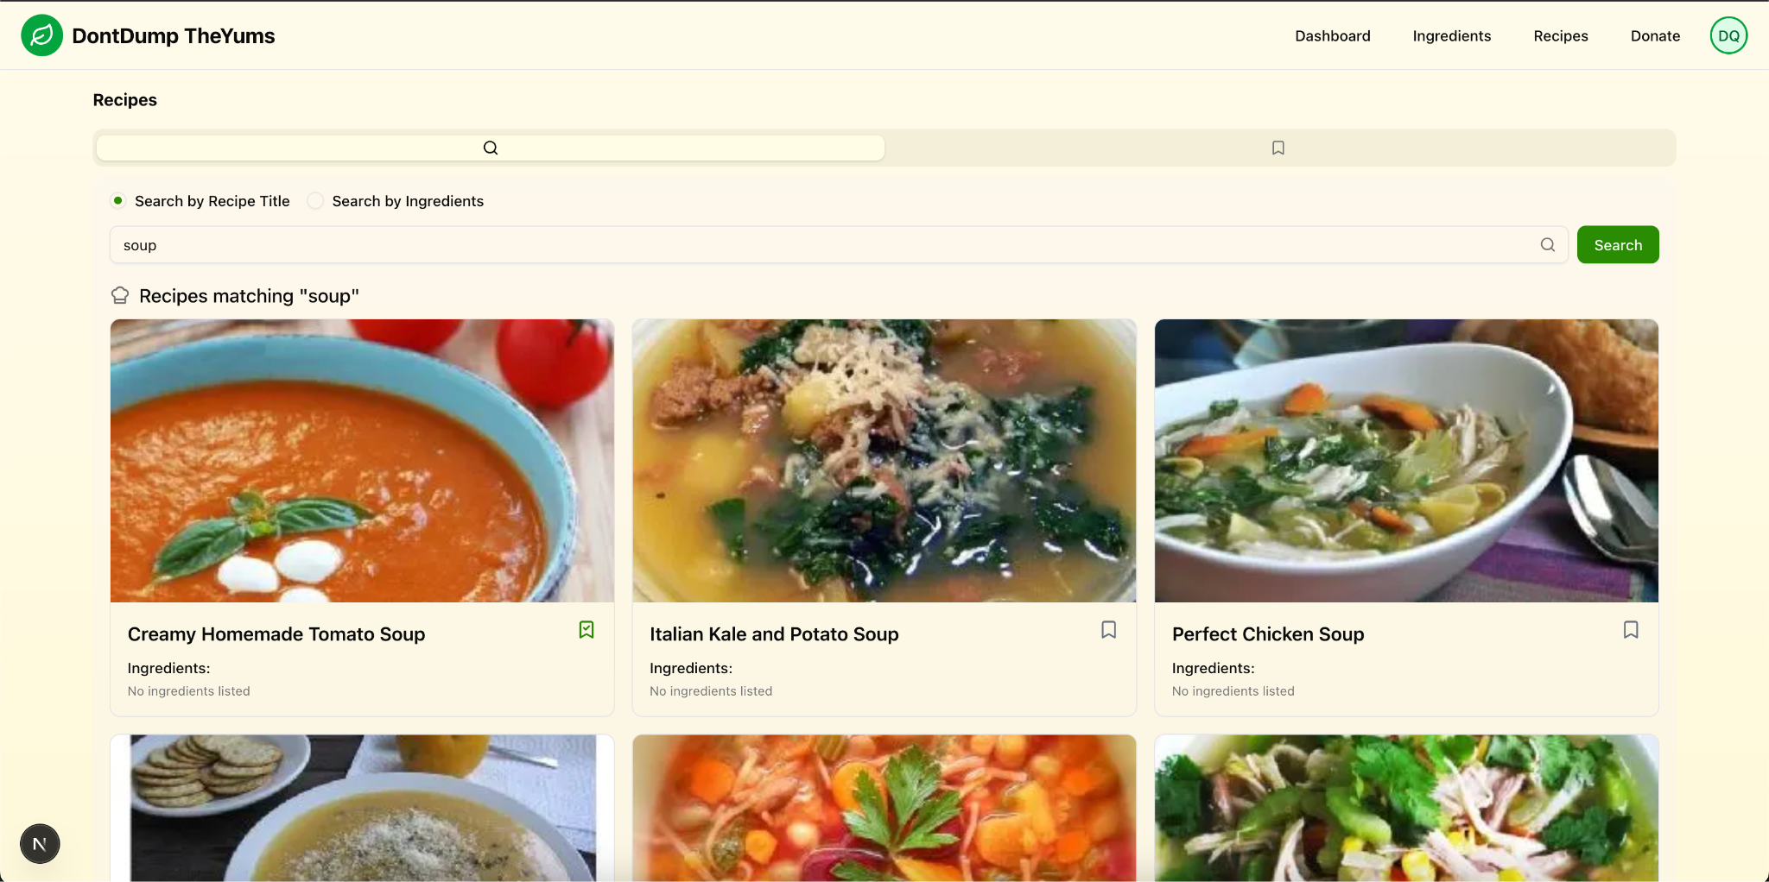
Recipe Search
Notes:
Daniel

Slide 9
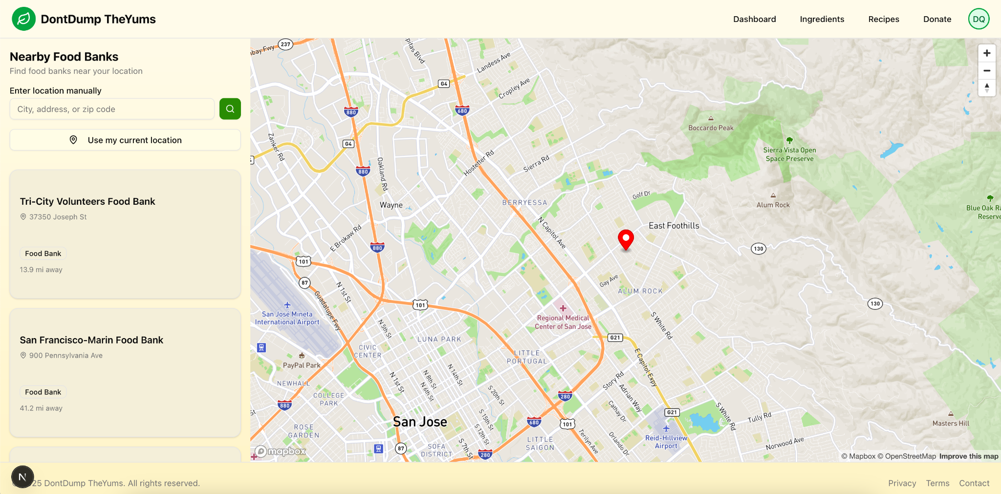
Food Banks Location/Search
Notes:
Gerald map box api

Slide 10
Future developments
Enhance AI capabilities
BackEnd scalabilities
AI assistant that provides users with storage recommendations for specific ingredients, helping reduce food waste
Database Design and Optimization,
Scalable Storage,
API and Load Handling
More features
Refining UI
Food Waste Analytics Dashboard, Sustainability Score / Impact Tracker, Meal Planning Integration, Smart Shopping List Generator
refining UI responsiveness/lags/design
Notes:
Gerald

Slide 11

Thanks!
Any Questions?

